Slide 1
Choosing the best Manhattan, NY neighborhood to Open Restaurant
Presented By: Syed Khaleduzzaman

Slide 2
Choosing the Right Neighborhood
Highly populated for continuous flow of patrons
Affluent neighborhood: affluent people go out to dine at restaurant more compare to people with lower income.
Concentrated cluster of Restaurants: Located within the highest concentration of restaurants. Patrons dines in the areas where multiple choices of restaurant are available just like people prefers shopping malls over local boutique because malls have more choices.

Slide 3
Choosing the data source for Manhattan:
Data collected from source/s must contains following properties:
List of all the Zip Codes for Manhattan, NY
Average Household Income
Density of population
Geospatial data: Latitude and Longitude

Slide 4
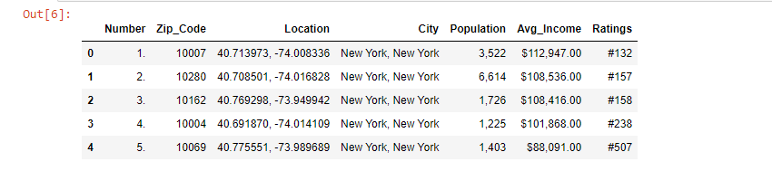
Choosing the data source for Manhattan:
Data source URL: http://zipatlas.com/us/ny/new-york/zip-code-comparison/median-household-income.htm

Slide 5
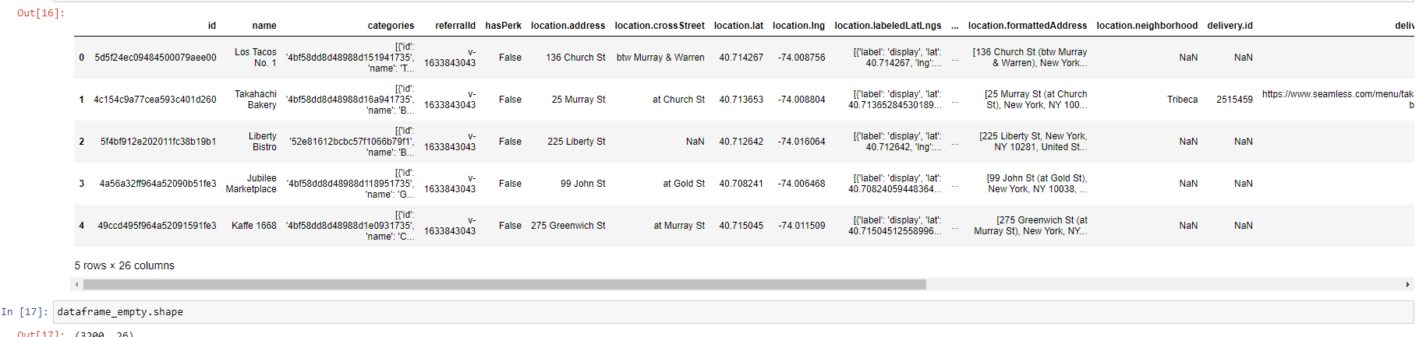
Compilation of Manhattan Zip Codes with Venues:
Using Foursquare API collection of Venues for each Manhattan, NY Zip Codes
Considering only Restaurant & ignoring other Venues

Slide 6
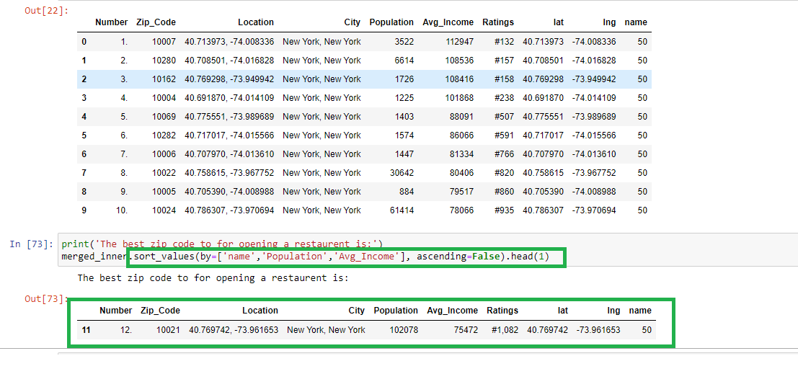

Choosing the best Zip Code:
Best Zip Code is the one with highest number of restaurants with highly dense
affluent people
Zip Code 10021 is the best!

Slide 7
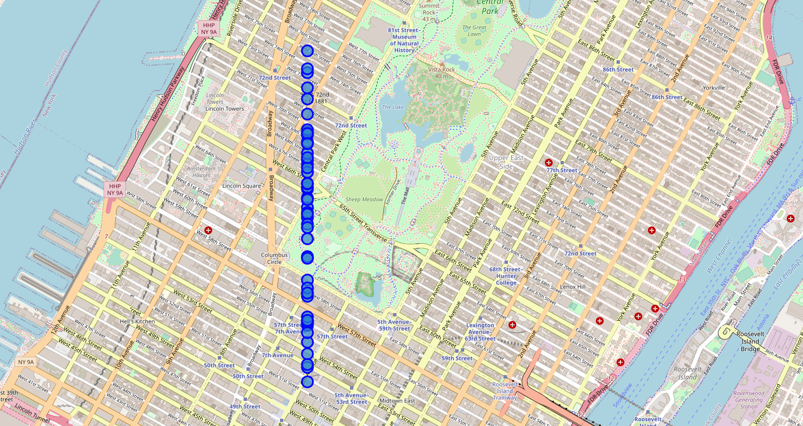
Mapping all the venues in the selected Zip Code:

Slide 8
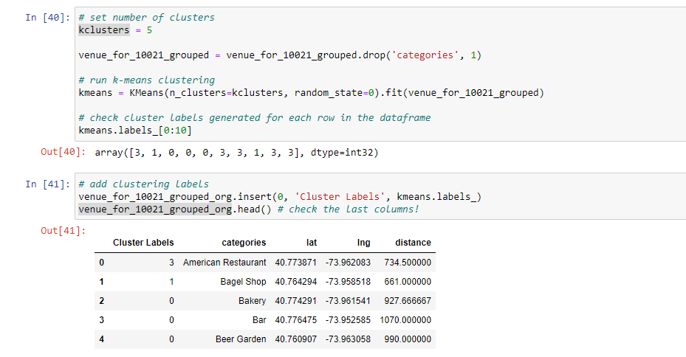
Using KNN to cluster the venues:
Use KNN machine learning algorithm, cluster each venue under the selected
Zip Code

Slide 9
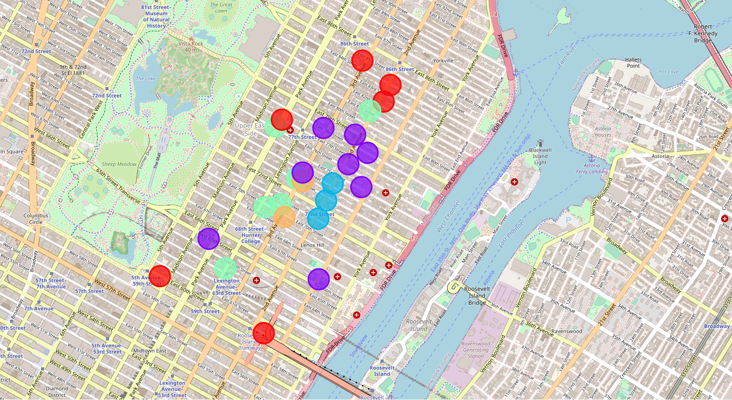
Mapping the clusters:

Slide 10
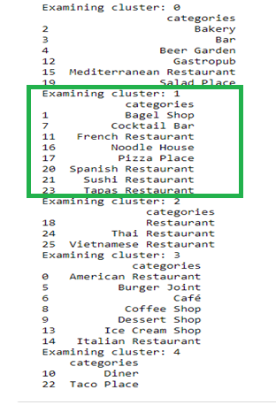
Examining & choosing the right Cluster:
The Right Cluster will have the most concentration of Restaurants
Cluster One is the best

Slide 11
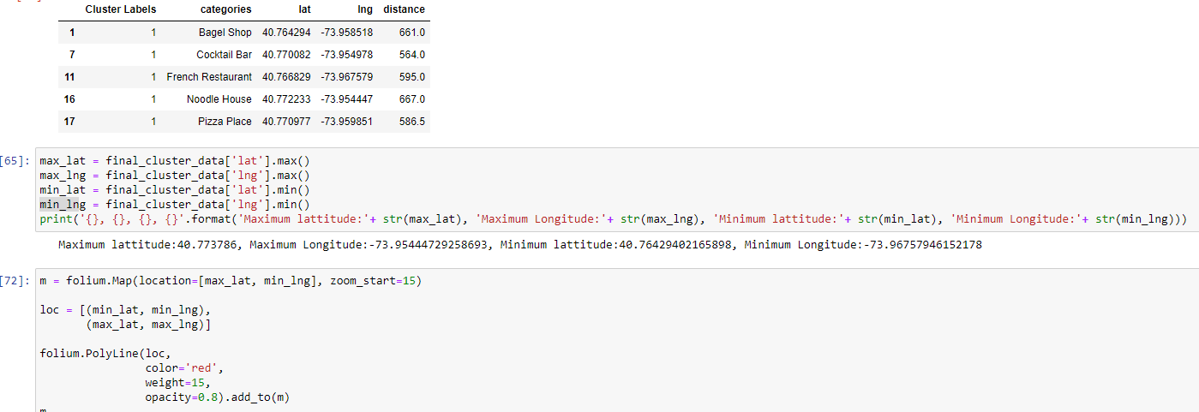
Setting the boundary of the right Cluster
To find the physical location of the selected cluster, we will draw boundaries
using max and min Latitude and Longitude of the venue within the cluster

Slide 12
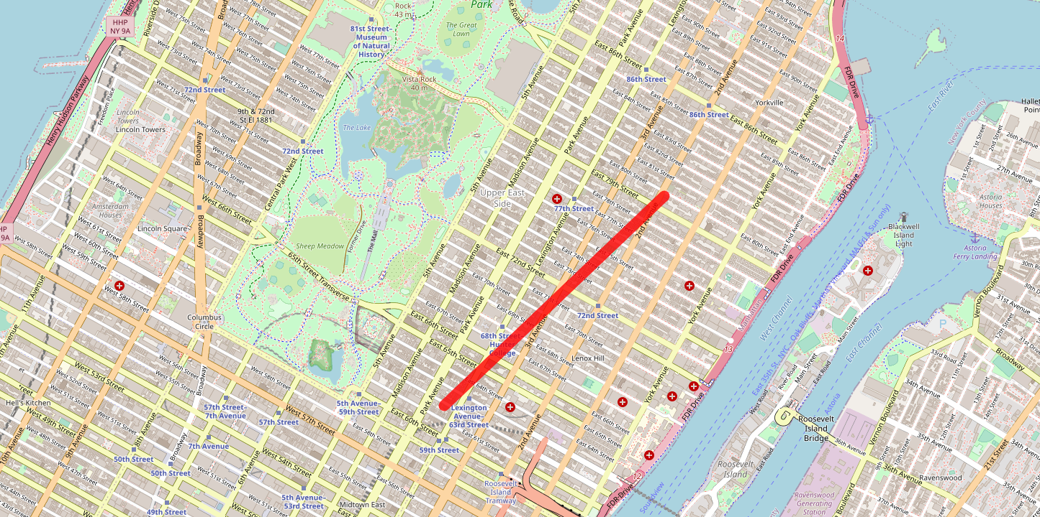
Mapping the right Neighborhood:
The suggested location: The diagonal corridor between Park Ave/63rd Street & 2nd Ave/80th Street

